Slide 1

NoSQL and JSON – Modern Data Storage
Paweł Rutkowski, Kacper Otręba, Miłosz Michalak 3E

Slide 2
Key Translations
Baza danych → Database
Zapytanie → Query
Skalowalność → Scalability
Struktura klucz-wartość → Key-value structure
Relacyjna baza danych → Relational database
Przetwarzanie danych → Data processing
Elastyczność → Flexibility
System rozproszony → Distributed system
Obsługa transakcji → Transaction support
Spójność danych → Data consistency
Replikacja danych → Data replication
Zbalansowane obciążenie → Load balancing
Analiza dużych zbiorów danych → Big Data analytics
Silnik rekomendacji → Recommendation engine

Slide 3
Introduction
Modern applications require flexible and scalable databases that can handle large amounts of data efficiently.
NoSQL databases are designed to store and manage unstructured or semi-structured data without requiring a fixed schema.
JSON (JavaScript Object Notation) is a lightweight data format that enables easy storage, exchange, and processing of structured data.
Used extensively in real-time applications, web development, and cloud computing.

Slide 4
NoSQL – Key Features
Schema-free architecture – NoSQL databases allow flexible data models, which can evolve dynamically as application requirements change.
Horizontal scalability – Unlike relational databases, NoSQL databases can scale out across multiple servers, improving performance and fault tolerance.
Ideal for big data and distributed systems, where high availability and speed are crucial.

Slide 5
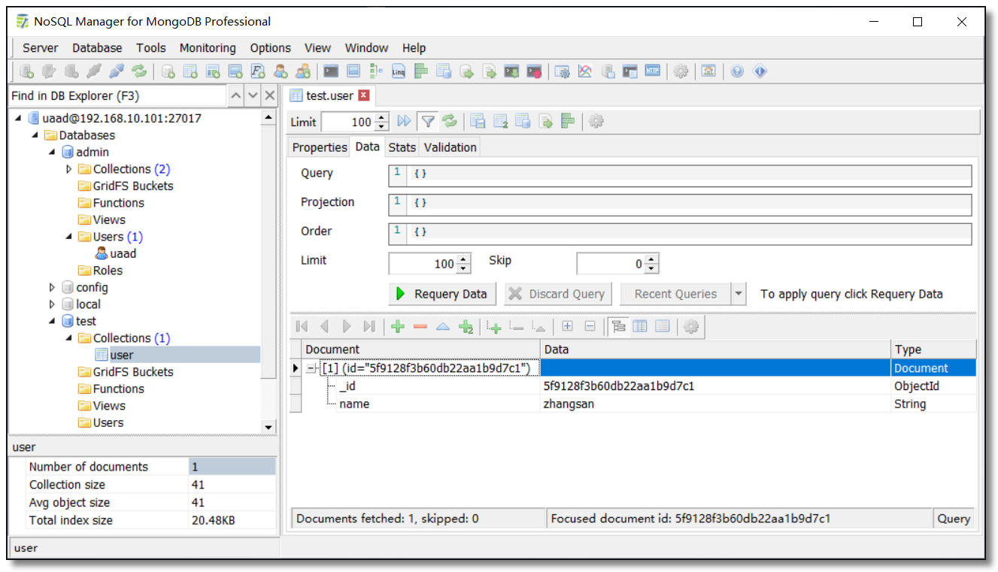

Document-based (e.g., MongoDB, CouchDB)
Stores data as JSON/BSON documents with nested fields and dynamic schemas.

Slide 6
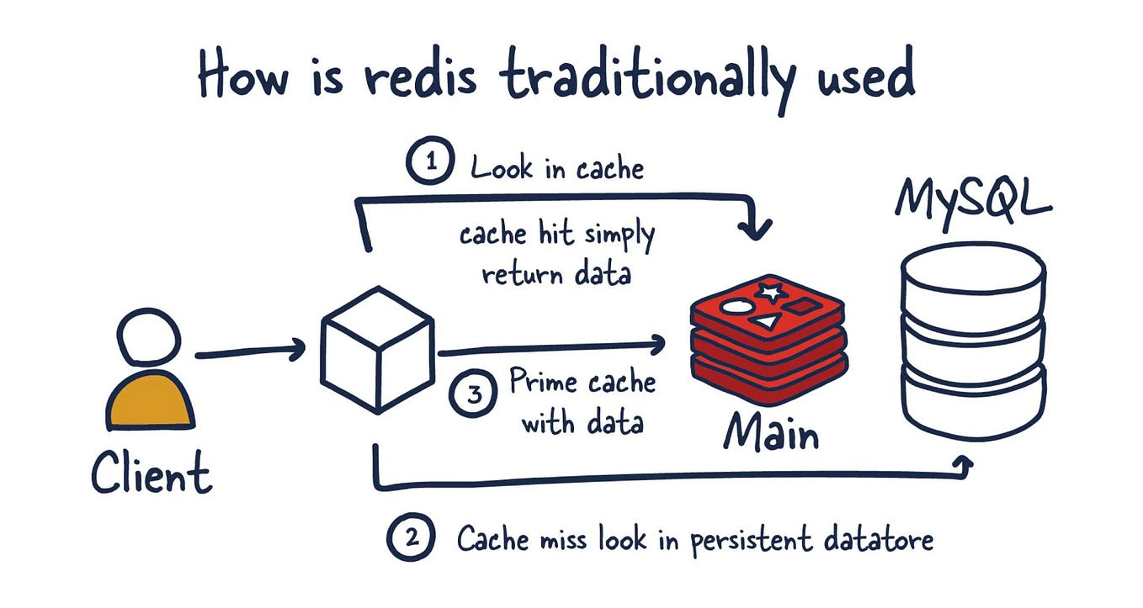

Key-value stores (e.g., Redis, DynamoDB)
High-speed retrieval of data using unique keys, useful for caching and session management.

Slide 7
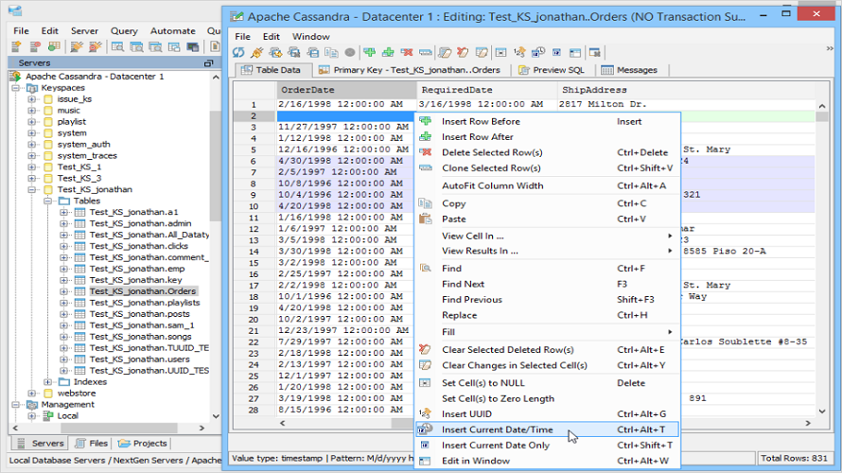

Column-family stores (e.g., Cassandra, HBase)
Optimized for high-throughput applications, stores data in columns instead of rows.

Slide 8
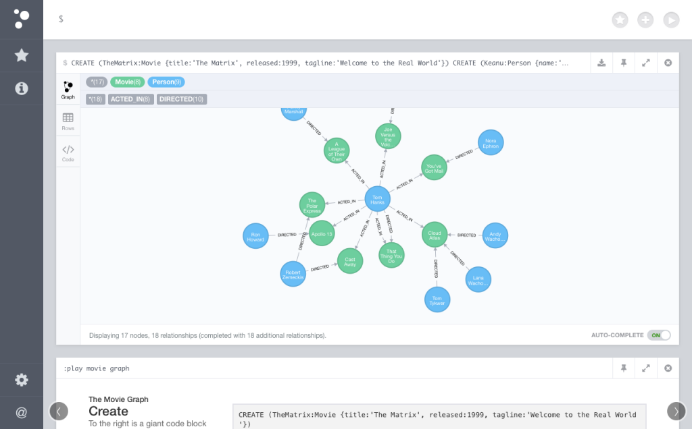
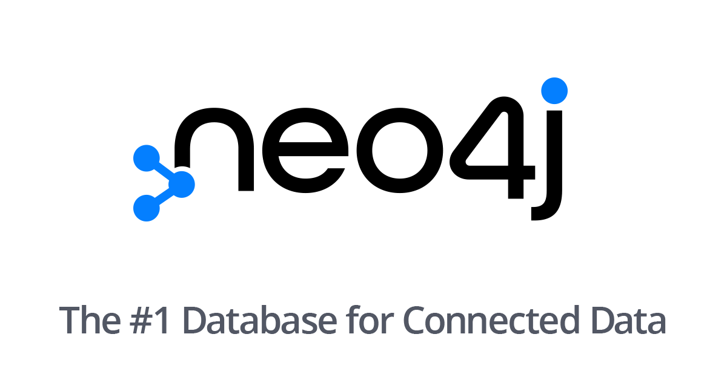
Graph databases (e.g., Neo4j, ArangoDB)
Stores and queries complex relationships between data nodes, ideal for recommendation engines and social networks.

Slide 9
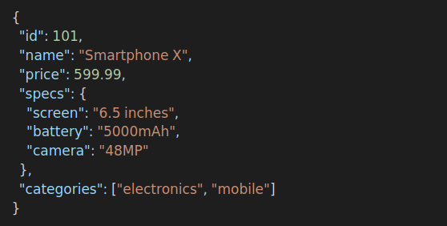
JavaScript Object Notation
– Basics and Usage
Lightweight and human-readable format – Uses key-value pairs to represent structured data in a hierarchical way.
Supported by multiple programming languages – JSON is widely used in JavaScript, Python, Java, and more.
Flexible structure – Can store primitive values, arrays, or nested objects, making it suitable for dynamic applications.
Common uses of JSON:
APIs (REST & GraphQL) – JSON is the primary format for data exchange between web servers and clients.
Configuration files – Used in software applications for settings storage (e.g., .json files in Node.js projects).
NoSQL databases – MongoDB and CouchDB use JSON/BSON as their primary data format.
Example of JSON:

Slide 10
Advantages and Disadvantages of NoSQL and JSON
Advantages:
Scalability – Handles large data sets efficiently using distributed architectures.
High-speed operations – No complex joins, optimized for quick reads and writes.
Flexibility – Stores semi-structured data without needing schema migrations.
Cloud-friendly – Works well with modern cloud platforms like AWS, Azure, and Google Cloud.
Disadvantages:
No universal query language – Unlike SQL, different NoSQL databases have their own query syntax.
Eventual consistency – Many NoSQL systems prioritize availability over immediate consistency.
Limited ACID compliance – Transactions may not always be fully atomic, consistent, isolated, and durable.
Data redundancy – Duplication of data may occur due to denormalization in document-based models.

Slide 11
Applications of NoSQL and JSON
Web and mobile applications – Handles real-time data storage and retrieval for user sessions and preferences.
Big Data and analytics – Processes and stores large-scale structured and unstructured data for insights.
E-commerce and product catalogs – Flexible schema allows easy management of diverse product attributes.
Internet of Things (IoT) – Stores sensor data streams and device interactions efficiently.
AI and machine learning – Used for feature storage, model training logs, and metadata management.
Logging and monitoring systems – NoSQL databases store system logs for real-time analysis and debugging.
Social media and recommendation engines – Graph databases model user interactions and preferences effectively.

Slide 12
Kahoot
https://create.kahoot.it/details/fe3c2a12-5945-4df0-bd59-7da10a38c3ba

